Slide 1
Maximum Likelihood Estimation of the Proportion of Hatchery-Origin Fish on Spawning Grounds Using Coded-Wire and Parentage-Based Tagging
by
Richard Hinrichsen, Shawn Narum, Matt Campbell, Mike Ackerman, Craig Steele, Maureen Hess, Bill Young, Barbara Shields, Brian Maschhoff
Funded by: Bonneville Power Administration

Slide 2
Why Estimate Proportion of Hatchery-Origin Fish On Spawning Grounds?
These fish originate in a hatchery, are released as juveniles, and return to spawn in the wild.
Influx of hatchery-origin spawners influences population dynamics by artificially increasing spawner numbers.
Influences: density dependence, reproductive success.
Genetic effects (Christie et al. 2012).
Mark R. Christie, Melanie L. Marine, Rod A. French, and Michael S. Blouin. 2012. Genetic adaptation to captivity can occur in a single generation. PNAS 109:238-242.
Notes:
Clear why p is important.

Slide 3
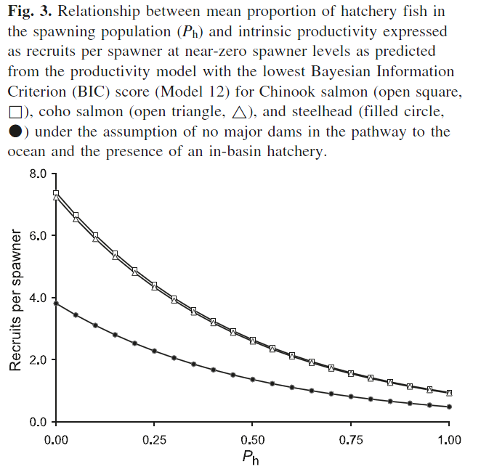
Source: Chilcote et al. (2011) CJFAS
Notes:
As the proportion of hatchery-origin fish on spawning grounds increases, productivity decreases. Chilcote et al. (2011) found that a naturally spawning population composed entirely of hatchery-origin spawners would have a reproductive performance that is 0.128 of that expected for a population composed entirely of wild-origin spawners.
The study was based on 93 salmon populations in Oregon, Washington, and Idaho, that were known to contain both wild- and hatchery-origin fish. Three species were represented: steelhead, coho and chinook.

Slide 4
An Easy Solution
Use constant visual marking (VM) fraction at all source hatcheries. For example, λ = 0.25. In that case,
is an estimate of the proportion of hatchery-origin spawners on the spawning grounds.
Notes:
When life is simple, each marked fish represents 4 hatchery fish. Visible implant elastomer tags (VIE) or Adipose fin clip

Slide 5
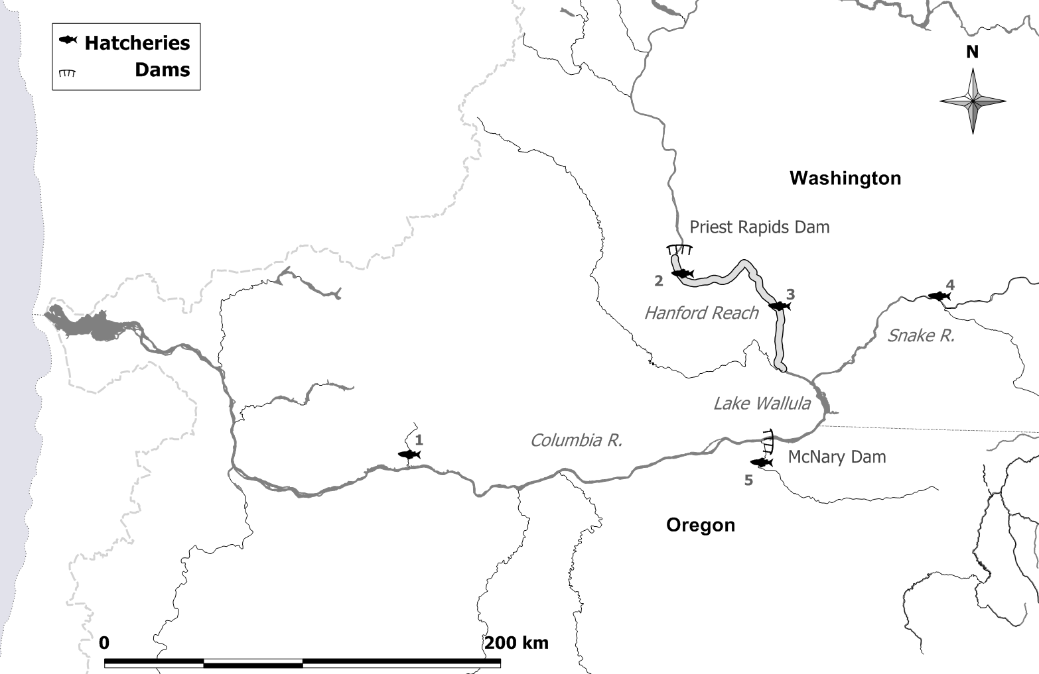
HANFORD REACH EXAMPLE
Priest Rapids H
Lyons Ferry H
Ringold Springs H
Little White Salmon NFH
Umatilla H
Source: Hinrichsen, Sharma, and Fisher (2012). TAFS.

Slide 6
Visible marking of hatchery releases that provided spawner inputs to Hanford Reach spawning grounds in 2010.
Hatchery | Brood year | VM fraction, λ
Little White Salmon NF | 2005 | 1.00
Priest Rapids | 2005 | 0.27
 | 2007 | 0.04
Ringold Springs | 2006 | 0.07
 | 2007 | 0.79
Lyons Ferry | 2006 | 0.51
Umatilla | 2007 | 1.00
Notes:
VM fractions of hatchery releases are not constant.

Slide 7
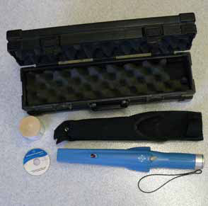
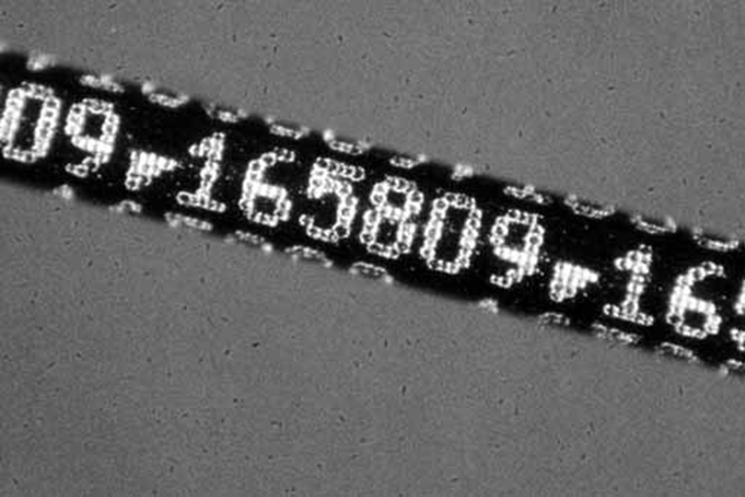
Using Coded-Wire Tags To Estimate p
Besides receiving a visible mark, some juvenile fish are tagged with a coded-wire tag (CWT) that identifies the hatchery of origin.
Adult fish on spawning grounds are sampled and tested for the presence of a CWT.

Slide 8
Ambiguity In Hatchery Of Origin
Hatchery #1
Hatchery #2
Hatchery #3
S p a w n i n g G r o u n d s
CWT
CWT
CWT
SAMPLE

Slide 9
VM or CWT In 2010 Hanford Reach Carcass Survey
Notes:
About 10,000 carcasses surveyed.

Slide 10
Influence of subsample rate and tagging fraction on precision of p
Subsample rate
Tagging fraction
Notes:
Hanford Reach Example varying subsample rate and tagging fraction.

Slide 11
CV Vs. Expected Tag Recoveries
Notes:
It’s clear that the driving variable determining CV is expected tag recoveries.

Slide 12
Parentage-Based Tagging
Parentage-based tagging (PBT)
Genotyping can be used to determine parents and therefore, hatchery of origin and brood year.
Increased tagging fractions may help solve problem of ambiguity in determining hatchery of origin.
Notes:
Genotype hatchery broodstock with SNPs and record genotypes in a data base of parents.
Sample carcasses on spawning grounds.
Determine if carcass genotype comes from parents in data base (is tagged) (Anderson 2010).
Use tag to determine release group.
Anderson, E.C. 2010. Computational algorithms and user-friendly software for parentage-based tagging of Pacific salmonids. SWFSC Final Report 10 March 2010.

Slide 13
PBT: The Good, Bad, and the Ugly
Good: Increases the number of tagged fish to nearly 100%
Bad: Family sizes are not homogeneous (winners and losers).
Ugly: Carcass decay can ruin PBT tags.

Slide 14
Maximum Likelihood Estimation
The probability model divides carcasses in the sample into different categories: tagged, untagged, undetermined tag, marked, unmarked, and undetermined mark. The effects of carcass decay are included.
We obtain estimates of each release’s contribution to fish on the spawning grounds (p_{i}) as well as total hatchery-origin contribution (p).

Slide 15
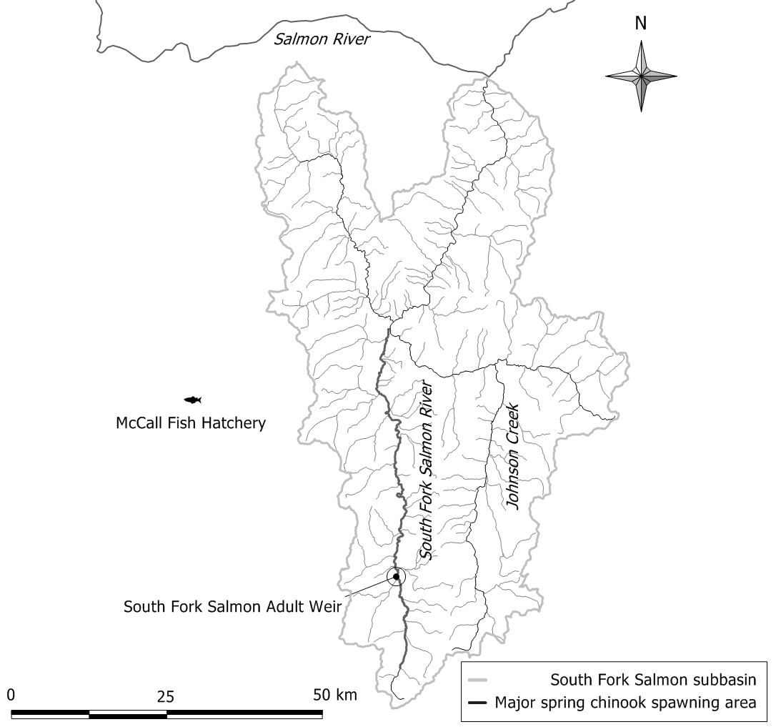

Slide 16
Notes:
PBT tag recoveries are close to 50 while CWT recoveries are close to 10.

Slide 17
Visible marking and parentage-based tagging at McCall Hatchery, which provided adult fish inputs to South Fork Salmon River spawning area in 2012. N = 218 carcasses in sample. Bolded counts represent tagged carcass recoveries.
 |  | PBT data |  |  |  |  | CWT data
Brood year | VM fraction | PBT fraction | VM subsample | non-VM subsample | undetermined VM subsample |  | CWT fraction | VM subsample | non-VM subsample | underdetermined VM subsample
2007 | 0.98 | 0.00 | 0 | 0 | 0 |  | 0.24 | 3 | 0 | 0
2008 | 0.98 | 0.98 | 42 | 2 | 0 |  | 0.20 | 9 | 1 | 0
2009 | 0.98 | 0.96 | 1 | 0 | 0 |  | 0.19 | 0 | 0 | 0
Un-tagged | NA | NA | 16 | 128 | 0 |  | NA | 52 | 153 | 0
Undet. | NA | NA | 5 | 24 | 0 |  | NA | 0 | 0 | 0
TOTAL | NA | NA | 64 | 154 | 0 |  | NA | 64 | 154 | 0
Notes:
PBT produces more tag recoveries than CWT owing to the larger tagging fraction. It is still possible to infer the contribution of BY2007 by subtraction. This occurs because the VM fraction is constant allowing an estimate of the total p.

Slide 18
Visible marking and parentage-based tagging at McCall Hatchery, which provided adult fish inputs to South Fork Salmon River spawning area in 2013.; SBS = segregated brood stock program, IBS = integrated brood stock program. N = 153 carcasses in sample.. Bolded counts represent tagged carcass recoveries.
 |  | PBT data |  |  |  |  | CWT data
Brood year | VM fraction | PBT fraction | VM subsample | non-VM subsample | undetermined VM subsample |  | CWT fraction | VM subsample | non-VM subsample | underdetermined VM subsample
2008 | 0.98 | 0.98 | 6 | 1 | 1 |  | 0.20 | 1 | 0 | 0
2009 | 0.98 | 0.96 | 28 | 0 | 3 |  | 0.19 | 4 | 0 | 0
2010 (SBS) | 0.98 | 0.99 | 2 | 0 | 0 |  | 0.16 | 0 | 0 | 0
2010 (IBS) | 0.00 | 1.00 | 0 | 2 | 0 |  | 1.00 | 0 | 2 | 0
Un-tagged | NA | NA | 4 | 58 | 8 |  | NA | 47 | 87 | 12
Undet. | NA | NA | 12 | 28 | 0 |  | NA | 0 | 0 | 0
Total | NA | NA | 52 | 89 | 12 |  | NA | 52 | 89 | 12
Notes:
All carcasses in sample are categorized. Note that some fish with undetermined VM are discovered to be of hatchery-origin with PBT but not with CWT.

Slide 19
Maximum likelihood estimates of proportions of hatchery-origin adult fish in South Fork Salmon River spawning areas in 2012 and 2013 using PBT and CWT data; SBS = segregated brood stock program, IBS = integrated brood stock program. The asterisk “*” indicates a bootstrap estimate.
 | PBT data |  |  |  |  |  | CWT data
Brood year | p | SE | CV | SE* | CV* |  | p | SE | CV
 | 2012 survey
2007 | 0.081 | 0.021 | 0.264 | 0.022 | 0.266 |  | 0.059 | 0.031 | 0.531
2008 | 0.238 | 0.032 | 0.134 | 0.032 | 0.135 |  | 0.244 | 0.040 | 0.164
2009 | 0.006 | 0.006 | 1.036 | 0.005 | 0.954 |  | 0.000 | 0.000 | NA
Total | 0.324 | 0.034 | 0.105 | 0.034 | 0.104 |  | 0.303 | 0.031 | 0.104
 | 2013 survey
2008 | 0.075 | 0.026 | 0.342 | 0.025 | 0.340 |  | 0.072 | 0.044 | 0.617
2009 | 0.307 | 0.044 | 0.143 | 0.044 | 0.143 |  | 0.299 | 0.055 | 0.183
2010 (SBS) | 0.018 | 0.013 | 0.715 | 0.013 | 0.741 |  | 0.000 | 0.000 | NA
2010 (IBS) | 0.018 | 0.012 | 0.689 | 0.013 | 0.737 |  | 0.013 | 0.009 | 0.705
Total | 0.418 | 0.046 | 0.111 | 0.047 | 0.113 |  | 0.384 | 0.041 | 0.107
Notes:
Note that the brood-year specific ps tend to be more precise using PBT data than CWT data due to larger numbers of tag recoveries. We accounted for the effects of heterogeneity in family size using a bootstrapping technique (Appendix of paper).

Slide 20
Conclusions
Precision of the estimate of the proportion of hatchery-origin fish on spawning grounds increases with expected number of tag recoveries (whether CWT or PBT).
Small tagging fractions can lead to ambiguity in estimation of proportion of hatchery-origin fish on spawning grounds and loss of precision and accuracy.
In the Hanford Reach example, very few (23 carcasses out of 9,791) were found to have a CWT.
PBT has the potential to increase numbers of tagged carcasses and thereby increase precision of estimates of the proportion of hatchery-origin fish on spawning grounds.

Slide 21
Snake River Chinook
All Spring/Summer Chinook broodstock sampled since 2008

Slide 22
Collection

Slide 23
Snake River Steelhead
Majority sampled in 2008
All broodstock sampled since 2009

Slide 24
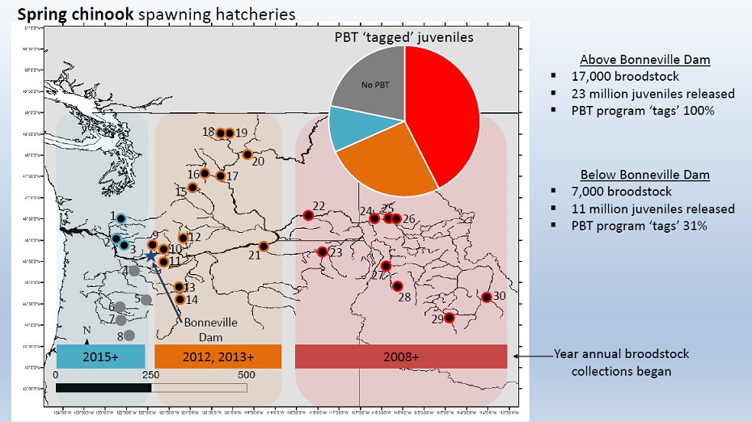

Slide 25
Hatcheries where genotyping of broodstock is conducted.
Map ID | Spawning hatchery | Map ID | Spawning hatchery
1 | Cowlitz Salmon | 16 | Leavenworth NFH
2 | Kalama Falls | 17 | Eastbank
3 | Lewis River | 18 | Methow
4 | Clackamas | 19 | Winthrop NFH
5 | Marion Forks | 20 | Chief Joseph
6 | South Santiam | 21 | Umatilla
7 | McKenzie | 22 | Lyons Ferry
8 | Willamette | 23 | Lookingglass
9 | Carson NFH | 24 | Nez Perce Tribal
10 | Little White Salmon NFH | 25 | Dworshak NFH
11 | Parkdale | 26 | Clearwater
12 | Klickitat | 27 | Rapid River
13 | Warm Springs NFH | 28 | SF Salmon, McCall
14 | Round Butte | 29 | Sawtooth
15 | Cle Elum SRF | 30 | Pahsimeroi

